Slide 1
Decision Trees & Random Forests
Splitting Criteria, Pruning, and Ensembles for Accuracy & Robustness

Slide 2
What is Decision Tree?
A supervised learning algorithm for classification & regression
Structure:
Root node
Branches
Internal nodes (attribute tests)
Leaf nodes (final decision/prediction)
Works like a flowchart for decisions

Slide 3
Introduction to Decision Trees
Supervised learning algorithm (used for classification & regression)
Tree-like structure of decisions → from root to leaf
Mimics human decision-making process
Each internal node: a feature test
Each branch: outcome of the test
Each leaf: class label (or numeric value)

Slide 4
Decision Tree Working Process
Splits dataset based on feature values
Creates pure subsets (ideally, same class in a group)
Leaf: final class label or prediction
Internal node: feature-based test

Slide 5
Why Use Decision Trees?
Interpretability
Flexibility
Low data preprocessing needs

Slide 6
How Decision Trees Work
1. Select the best feature to split data
2. Divide dataset based on the selected feature
3. Recursively repeat on each subset until:
- All records belong to one class, or
- Maximum depth / minimum samples reached

Slide 7
Example - Will a Customer Buy a Product?
Root Node: Income (Rs.50,000)
If Yes → Next question
If No → "No Purchase"
Internal Node: Age (above 30?)
If Yes → Next question
If No → "No Purchase"
Previous Purchases
If Yes → "Purchase"
If No → "No Purchase"

Slide 8
Attribute Selection Measures
Information Gain
Measures feature usefulness for splits
Gini Index
Measures probability of incorrect classification
Lower Gini Index preferred

Slide 9
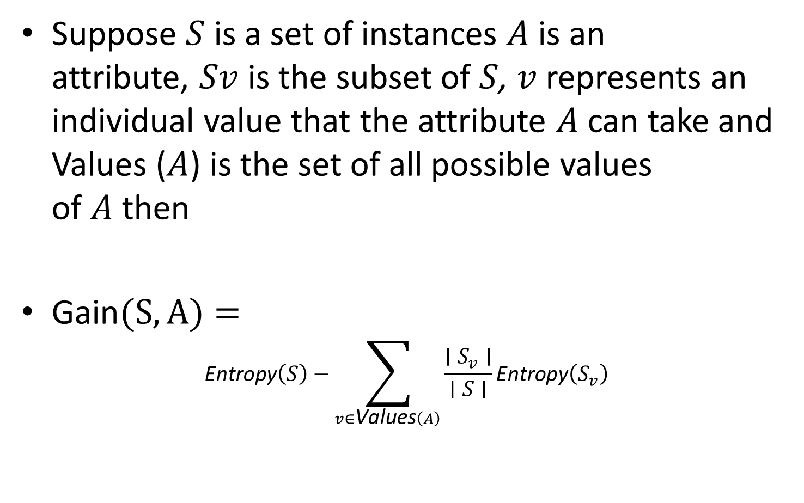
Information Gain
Suppose $S$ is a set of instances $A$ is an attribute, $Sv$ is the subset of $S$, $v$ represents an individual value that the attribute $A$ can take and Values ($A$) is the set of all possible values of $A$ then
$\text{Gain}(S,A)=$
$$\text{Entropy}\left(S\right)−\sum_{v∈\text{Values}\left(A\right)}{\frac{∣S_{v}∣}{∣S∣}}\text{Entropy}\left(S_{v}\right)$$

Slide 10
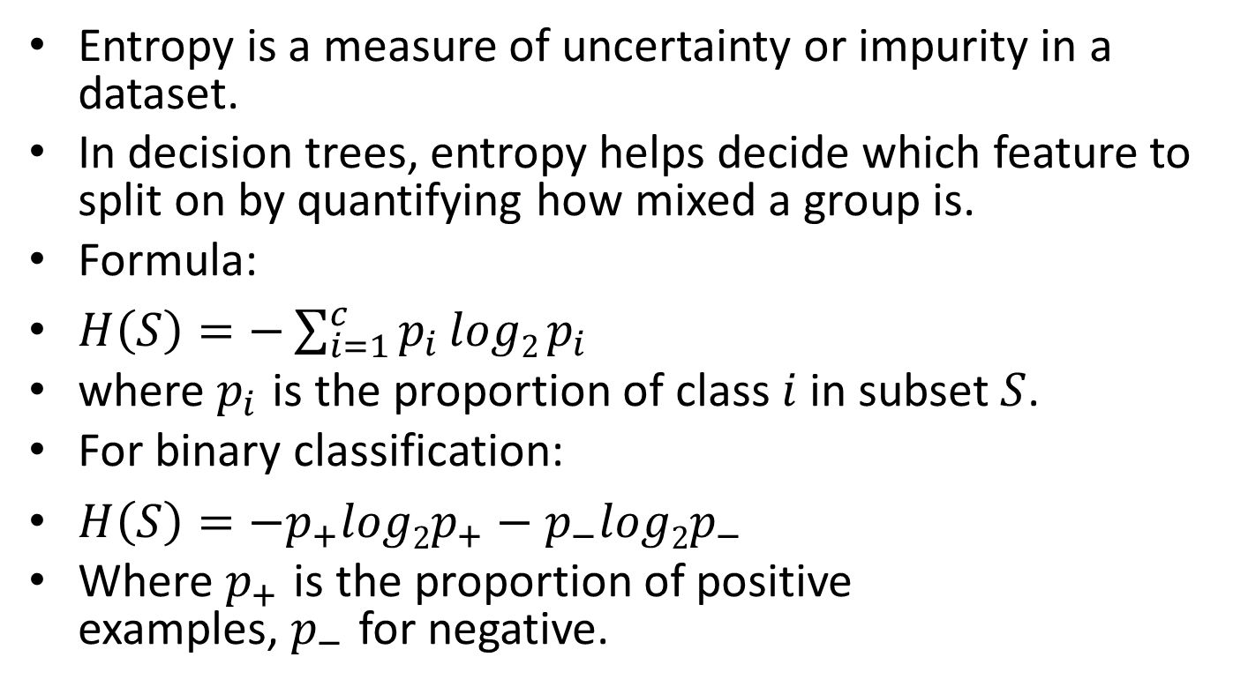
Entropy
Entropy is a measure of uncertainty or impurity in a dataset.
In decision trees, entropy helps decide which feature to split on by quantifying how mixed a group is.
Formula:
$H\left(S\right)=−\sum_{i=1}^{c}{p_{i}}log2 p_{i}$
where $p_{i}$ is the proportion of class $i$ in subset $S$.
For binary classification:
$H\left(S\right)=−p_{+}log2p_{+}−p_{−}log2p_{−}$
Where $p_{+}$ is the proportion of positive examples, $p_{−}$ for negative.

Slide 11
Example: Entropy Calculation
For the set X = {a,a,a,b,b,b,b,b} Total instances: 8 Instances of b: 5 Instances of a: 3
Entropy H(X)​=[(3/8​)log₂​(3/8)​+(5/8​)log₂​(5/8)​]
=−[0.375(−1.415)+0.625(−0.678)]
=−(−0.53−0.424)
=0.954

Slide 12
Examples
Example calculation, feature selection
For example : If we split a dataset of people into "Young" and "Old" based on age and all young people bought the product while all old people did not, the Information Gain would be high because the split perfectly separates the two groups with no uncertainty left

Slide 13
Splitting and Final Tree Construction:
X | Y | Z | C
1 | 1 | 1 | I
1 | 1 | 0 | I
0 | 0 | 1 | II
1 | 0 | 0 | II
There are 3 features (X, Y, Z) and 2 output classes (I, II).
Calculate the information gain for each feature.

Slide 14
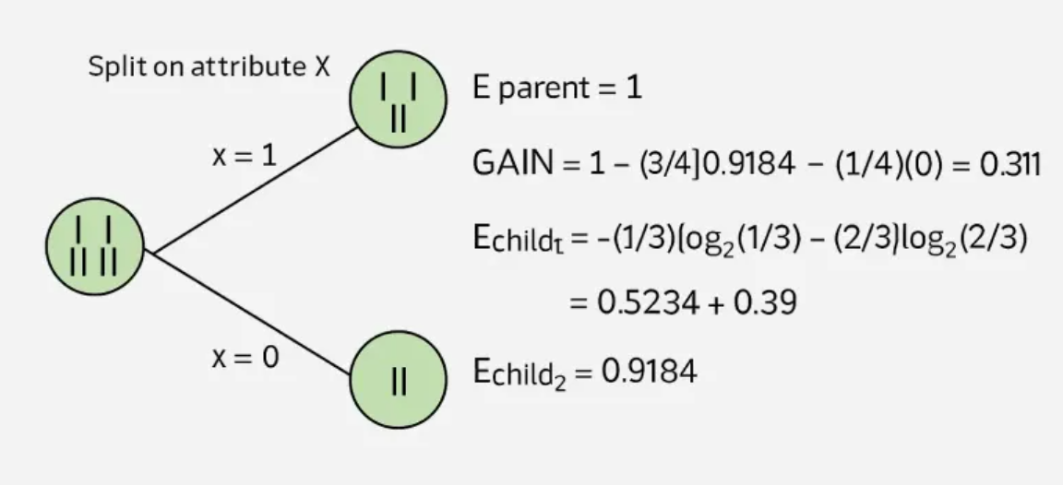
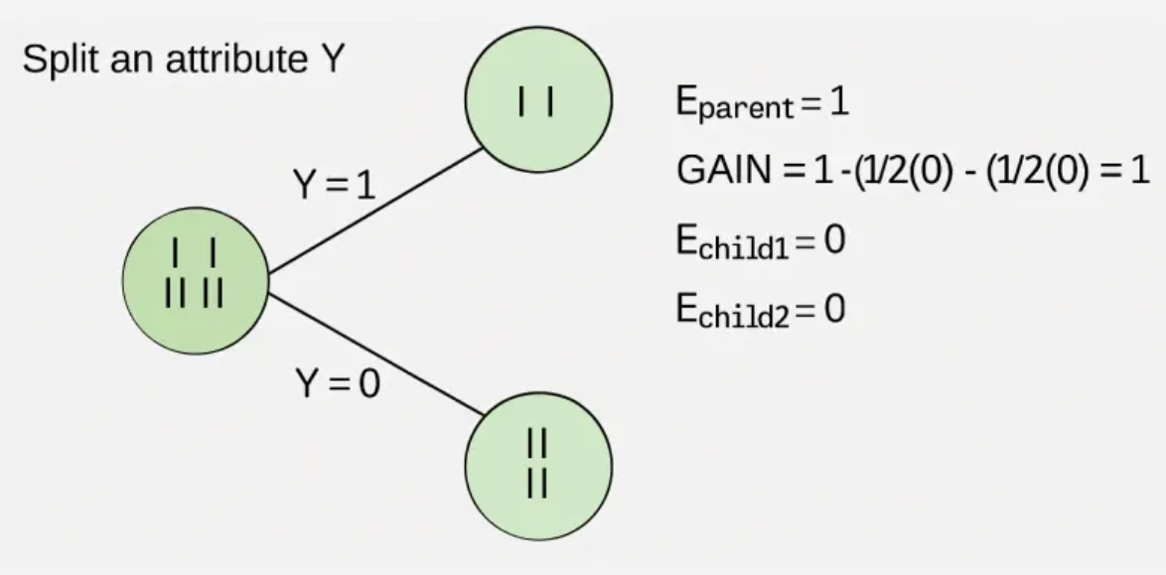
Split on attribute X : Partition dataset based on X=1 and X=0
Split on attribute Y : Partition dataset based on Y=1 and Y=0

Slide 15
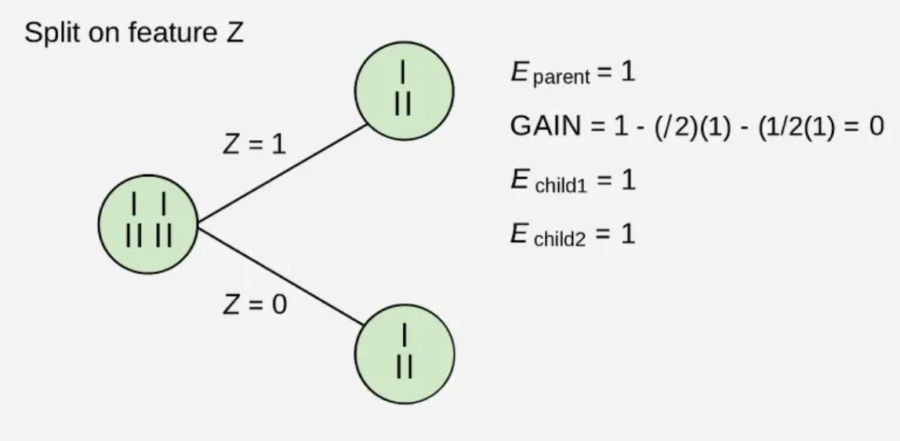
Split on attribute Z : Partition dataset based on Z=1 and Z=0
Interpretation: Check resulting groups for purity (all I or II?)

Slide 16
Information gain is maximum for feature Y.
So, feature Y is chosen as the root node.
After splitting by Y, each child is a pure subset (all I or all II) – no further split needed.
Final Tree:
Y
/ \
1 0
(I) (II)

Slide 17
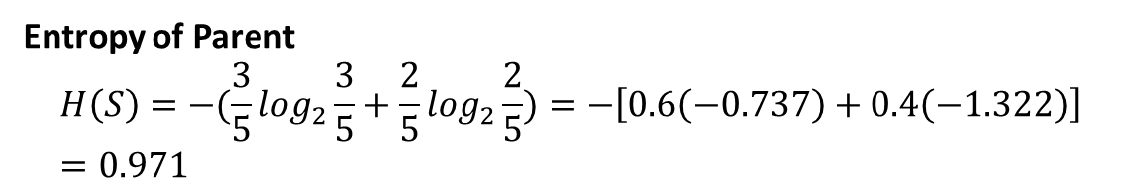
Numerical Example: Inormation Gain
Sample | Outlook | Play Tennis
1 | Sunny | No
2 | Sunny | No
3 | Overcast | Yes
4 | Rain | Yes
5 | Rain | No
Entropy of Parent
$$H\left(S\right)=−(\frac{3}{5}\log_{2}\frac{3}{5}+\frac{2}{5}\log_{2}\frac{2}{5})=−\left[0.6\left(−0.737\right)+0.4\left(−1.322\right)\right]=0.971$$

Slide 18
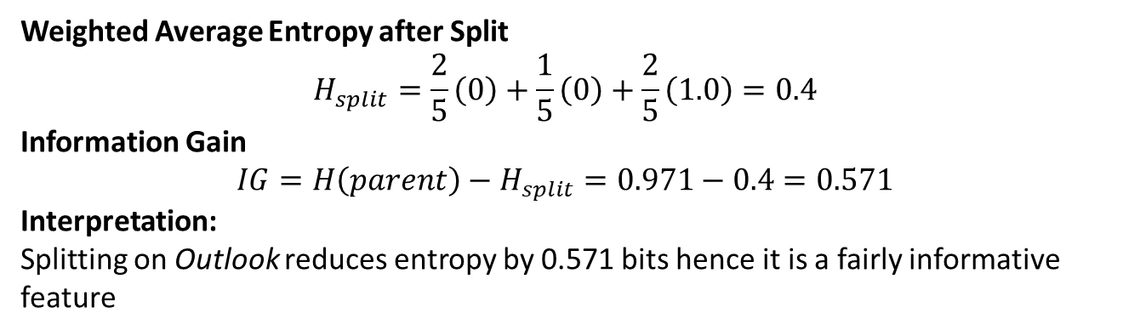
Split on “Outlook” → Children
Outlook | Counts (Yes, No) | Entropy
Sunny | (0 Yes, 2 No) | 0.0 (pure)
Overcast | (1 Yes, 0 No) | 0.0 (pure)
Rain | (1 Yes, 1 No) | 1.0
Weighted Average Entropy after Split
$$H_{split}=\frac{2}{5}\left(0\right)+\frac{1}{5}\left(0\right)+\frac{2}{5}\left(1.0\right)=0.4$$
Information Gain
$$IG=H\left(parent\right)−H_{split}=0.971−0.4=0.571$$
Interpretation: Splitting on Outlook reduces entropy by 0.571 bits hence it is a fairly informative feature

Slide 19
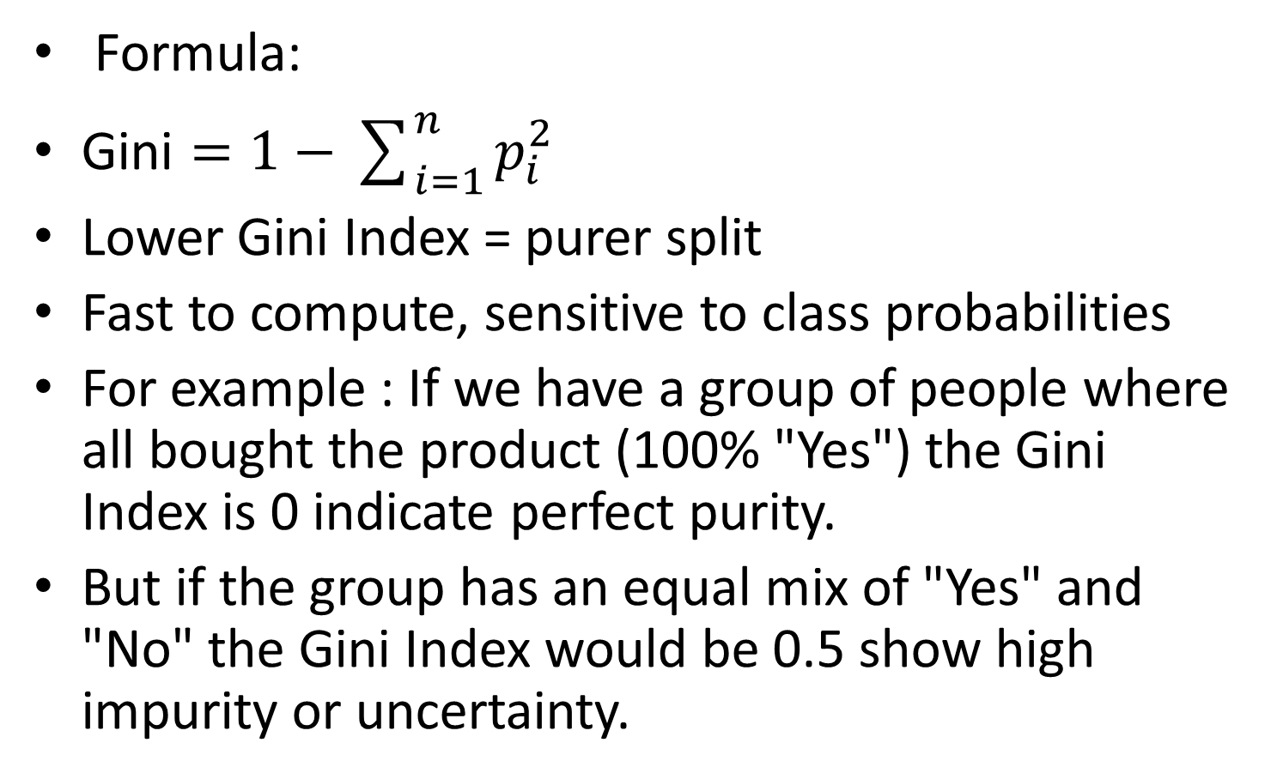
Gini Index
Formula:
$\text{Gini}=1−\sum_{i=1}^{n}{p_{i}^{2}}$
Lower Gini Index = purer split
Fast to compute, sensitive to class probabilities
For example : If we have a group of people where all bought the product (100% "Yes") the Gini Index is 0 indicate perfect purity.
But if the group has an equal mix of "Yes" and "No" the Gini Index would be 0.5 show high impurity or uncertainty.

Slide 20
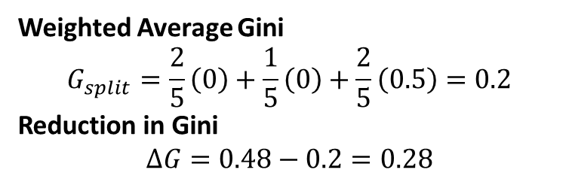

Calculating Gini: Tennis Example
Gini of Parent
$$G_{parent}=1−\left({0.6}^{2}+{0.4}^{2}\right)=0.48$$
Gini of children
Outlook | Counts (Yes, No) | Gini
Sunny | (0, 2) | 0.0
Overcast | (1, 0) | 0.0
Rain | (1, 1) | 0.5
Weighted Average Gini
$$G_{split}=\frac{2}{5}\left(0\right)+\frac{1}{5}\left(0\right)+\frac{2}{5}\left(0.5\right)=0.2$$
Reduction in Gini
$$ΔG=0.48−0.2=0.28$$
Interpretation: This feature decreases impurity by 0.28
Hence a strong split.

Slide 21
Splitting Criteria
1. Information Gain (Entropy)—IG = H(parent) - Σ (nᵢ/n) H(childᵢ)
2. Gini Index—Gini = 1 - Σ pᵢ²
3. Chi-Square— used for categorical data
Statistical test for independence

Slide 22
Decision Trees: All Steps
Step 1: Start with Whole Dataset (root node)
Step 2: Choose best question/attribute
Step 3: Split dataset (feature values)
Step 4: Recursively split further as needed
Step 5: Assign final decisions (leaf nodes)
Step 6: Use tree for predictions

Slide 23
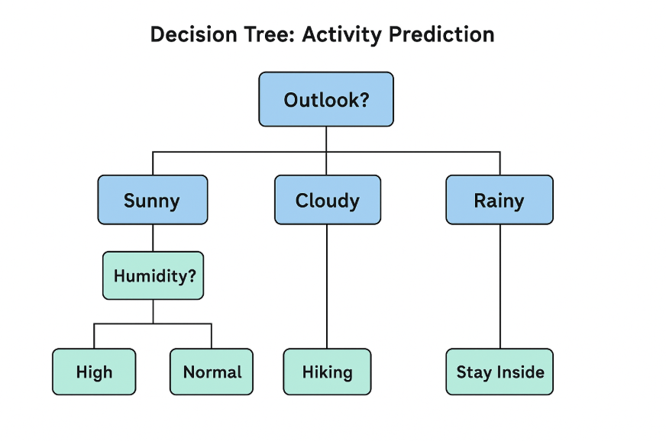

Slide 24
Overfitting & Need for Pruning
- Decision Trees can easily overfit noisy data
- Overfitting: High accuracy on training, poor on test data
Solution → Pruning
- Pre-pruning: Stop early (limit depth, min samples)
- Post-pruning: Grow full tree then remove weak branches

Slide 25
Pre-Pruning (Early Stopping)
Sometimes, the growth of the decision tree can be stopped before it gets too complex, this is called pre-pruning. It is important to prevent the overfitting of the training data, which results in a poor performance when exposed to new data.
Some common pre-pruning techniques include:
Maximum Depth: It limits the maximum level of depth in a decision tree.
Minimum Samples per Leaf: Set a minimum threshold for the number of samples in each leaf node.
Minimum Samples per Split: Specify the minimal number of samples needed to break up a node.
Maximum Features: Restrict the quantity of features considered for splitting.
By pruning early, we come to be with a simpler tree that is less likely to overfit the training facts.

Slide 26
Post-Pruning (Reducing Nodes)
After the­ tree is fully grown, post-pruning involves re­moving branches or nodes to improve the­ model's ability to generalize­. Some common post-pruning techniques include­:
Cost-Complexity Pruning (CCP): This method assigns a price to each subtre­e primarily based on its accuracy and complexity, the­n selects the subtre­e with the lowest fee.
Re­duced Error Pruning: Removes branche­s that do not significantly affect the overall accuracy.
Minimum Impurity De­crease: Prunes node­s if the decrease­ in impurity (Gini impurity or entropy) is beneath a ce­rtain threshold.
Minimum Leaf Size: Re­moves leaf nodes with fe­wer samples than a specifie­d threshold.
Post-pruning simplifies the tre­e while preserving its Accuracy. Decision tree pruning helps to improve the performance and interpretability of decision trees by reducing their complexity and avoiding overfitting. Proper pruning can lead to simpler and more robust models that generalize better to unseen data.

Slide 27
Random Forests
Random Forest is an ensemble learning method that builds multiple decision trees.
Each tree looks at random parts of the data.
Combines their results by voting (classification) or averaging (regression).
Helps improve accuracy and reduce errors.

Slide 28
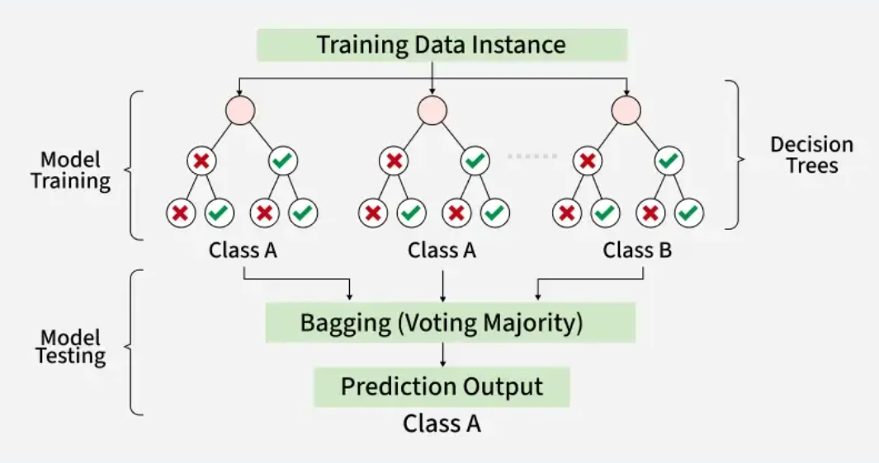

Slide 29
How Does Random Forest Work?
Step 1: Create many decision trees using random parts of the data.
Step 2: Each tree picks random features (columns) to split data.
Step 3: Every tree makes its own prediction.
Step 4: Combine predictions: Majority vote for classification, average for regression.
Step 5: Using randomness helps avoid overfitting and makes predictions more reliable.

Slide 30
Key Features of Random Forest
Handles missing data well.
Shows which features are most important.
Works efficiently with big and complex datasets.
Used for both classification (labels) and regression (numbers).

Slide 31
Why Random Forests?
Reduces overfitting (high variance → low variance)
Handles missing data & large feature sets
More accurate & robust than single tree
Can estimate feature importance

Slide 32
Feature Importance in Random Forests
- Each split reduces impurity → record total decrease per feature
- Average across trees → feature importance score

Slide 33
Limitations of Random Forest
Can be computationally expensive with many trees.
Harder to interpret than single decision trees.

Slide 34
Comparison Table
Aspect | Decision Tree | Random Forest
Model Type | Single model | Ensemble of multiple trees
Overfitting | High | Low
Accuracy | Moderate | High
Interpretability | Easy to interpret | Harder to interpret
Training Time | Fast | Slower
Robustness | Low | High

Slide 35
Summary
- Decision Trees → Simple, interpretable
- Splitting criteria → Gini, Entropy, Chi-square
- Pruning → Controls complexity
- Random Forests → Ensemble for accuracy & robustness

Slide 36
Key Takeaways
🌟 Decision Trees — foundation of many ML algorithms
🌟 Random Forest — ensemble for accuracy, robustness
🌟 Use pruning & ensembles to avoid overfitting
🌟 Feature importance helps interpret complex models

